Slide 1
Construction Law Services LLC
James G. McConnell
Attorney at Law
Suite 208
11966 H Oak Creek Parkway
Huntley, Illinois 60142
Phone (630) 748-8036
Fax (630) 243-5682
Worldwide Cellular (312) 287-1343
E-mail
james.mcconnell@james-g-mcconnell.com

Slide 2
Town Center Realty Façade Renovations
Applying for a Village grant for new windows
Application states “I have plans for much more down the road.”
CONTACT:
Paul Godlewski
Managing Broker
Town Center Realty Group LLC
P. O. Box 64
Huntley, Illinois 60142-0064
847-961-6300 x 11
E-mail
mrpaul2u70@aol.com

Slide 3
SE Corner Grove & Main
Property already rezoned for use as a dental office
Single Family Residence with Garage to be razed
One story dental office building to be constructed

Slide 4
Faubl Family Dentistry
CONTACTS:
OWNER:
John R. Faubl DDS
Faubl Family Dentistry
10399 Vine Street
Huntley, Illinois 60142
847-515-2400
ARCHITECT:
Angus Young Architecture
555 South River Street
Janesville, Wisconsin 53548-4783
608-756-2326

Slide 5
Huntley Library Expansion
2005 Bond Issue defeated
2008 $9.5 million Bond Issue defeated

Slide 6
Huntley Library Expansion
East wing with meeting room and children’s area is in trailers
$9.5 million would have tripled building size
New library director Frank Novak wants to find a way to fund the expansion

Slide 7
Construction Law Services LLC
James G. McConnell
Attorney at Law
Suite 208
11966 H Oak Creek Parkway
Huntley, Illinois 60142
Phone (630) 748-8036
Fax (630) 243-5682
Worldwide Cellular (312) 287-1343
E-mail
james.mcconnell@james-g-mcconnell.com

Slide 8
Construction Contract Payments In Illinois
Part Two
Mechanics Liens
On Public Projects
Notes:
After I graduated from law school, my very first client was American Bridge Division of United States Steel Corporation. For 37 years I have provided construction law services to public and private owners, developers, lenders, title insurers, contractors, subcontractors, material suppliers, utilities, and performance and payment bond sureties across Illinois. I have also served as trial counsel in cases in California, Connecticut, the District of Columbia, Indiana, Nevada, New York, Ohio and Texas. In addition, I have handled international matters involving parties from Brazil, Canada, England, France and Mexico, and I have lectured on international construction law issues in Austria and China as well as here in the United States.

Slide 9
Lien On Public Funds
No liens on public property
Recording lien notice has no effect
Substitute lien on unspent, appropriated funds for state and local projects
No lien protection on federally owned projects

Slide 10
Sworn Statement Essentials
Sworn statement must balance
All work must be included
Scope changes must be documented
Disputed items must be identified
Architect certificate in support of progress

Slide 11
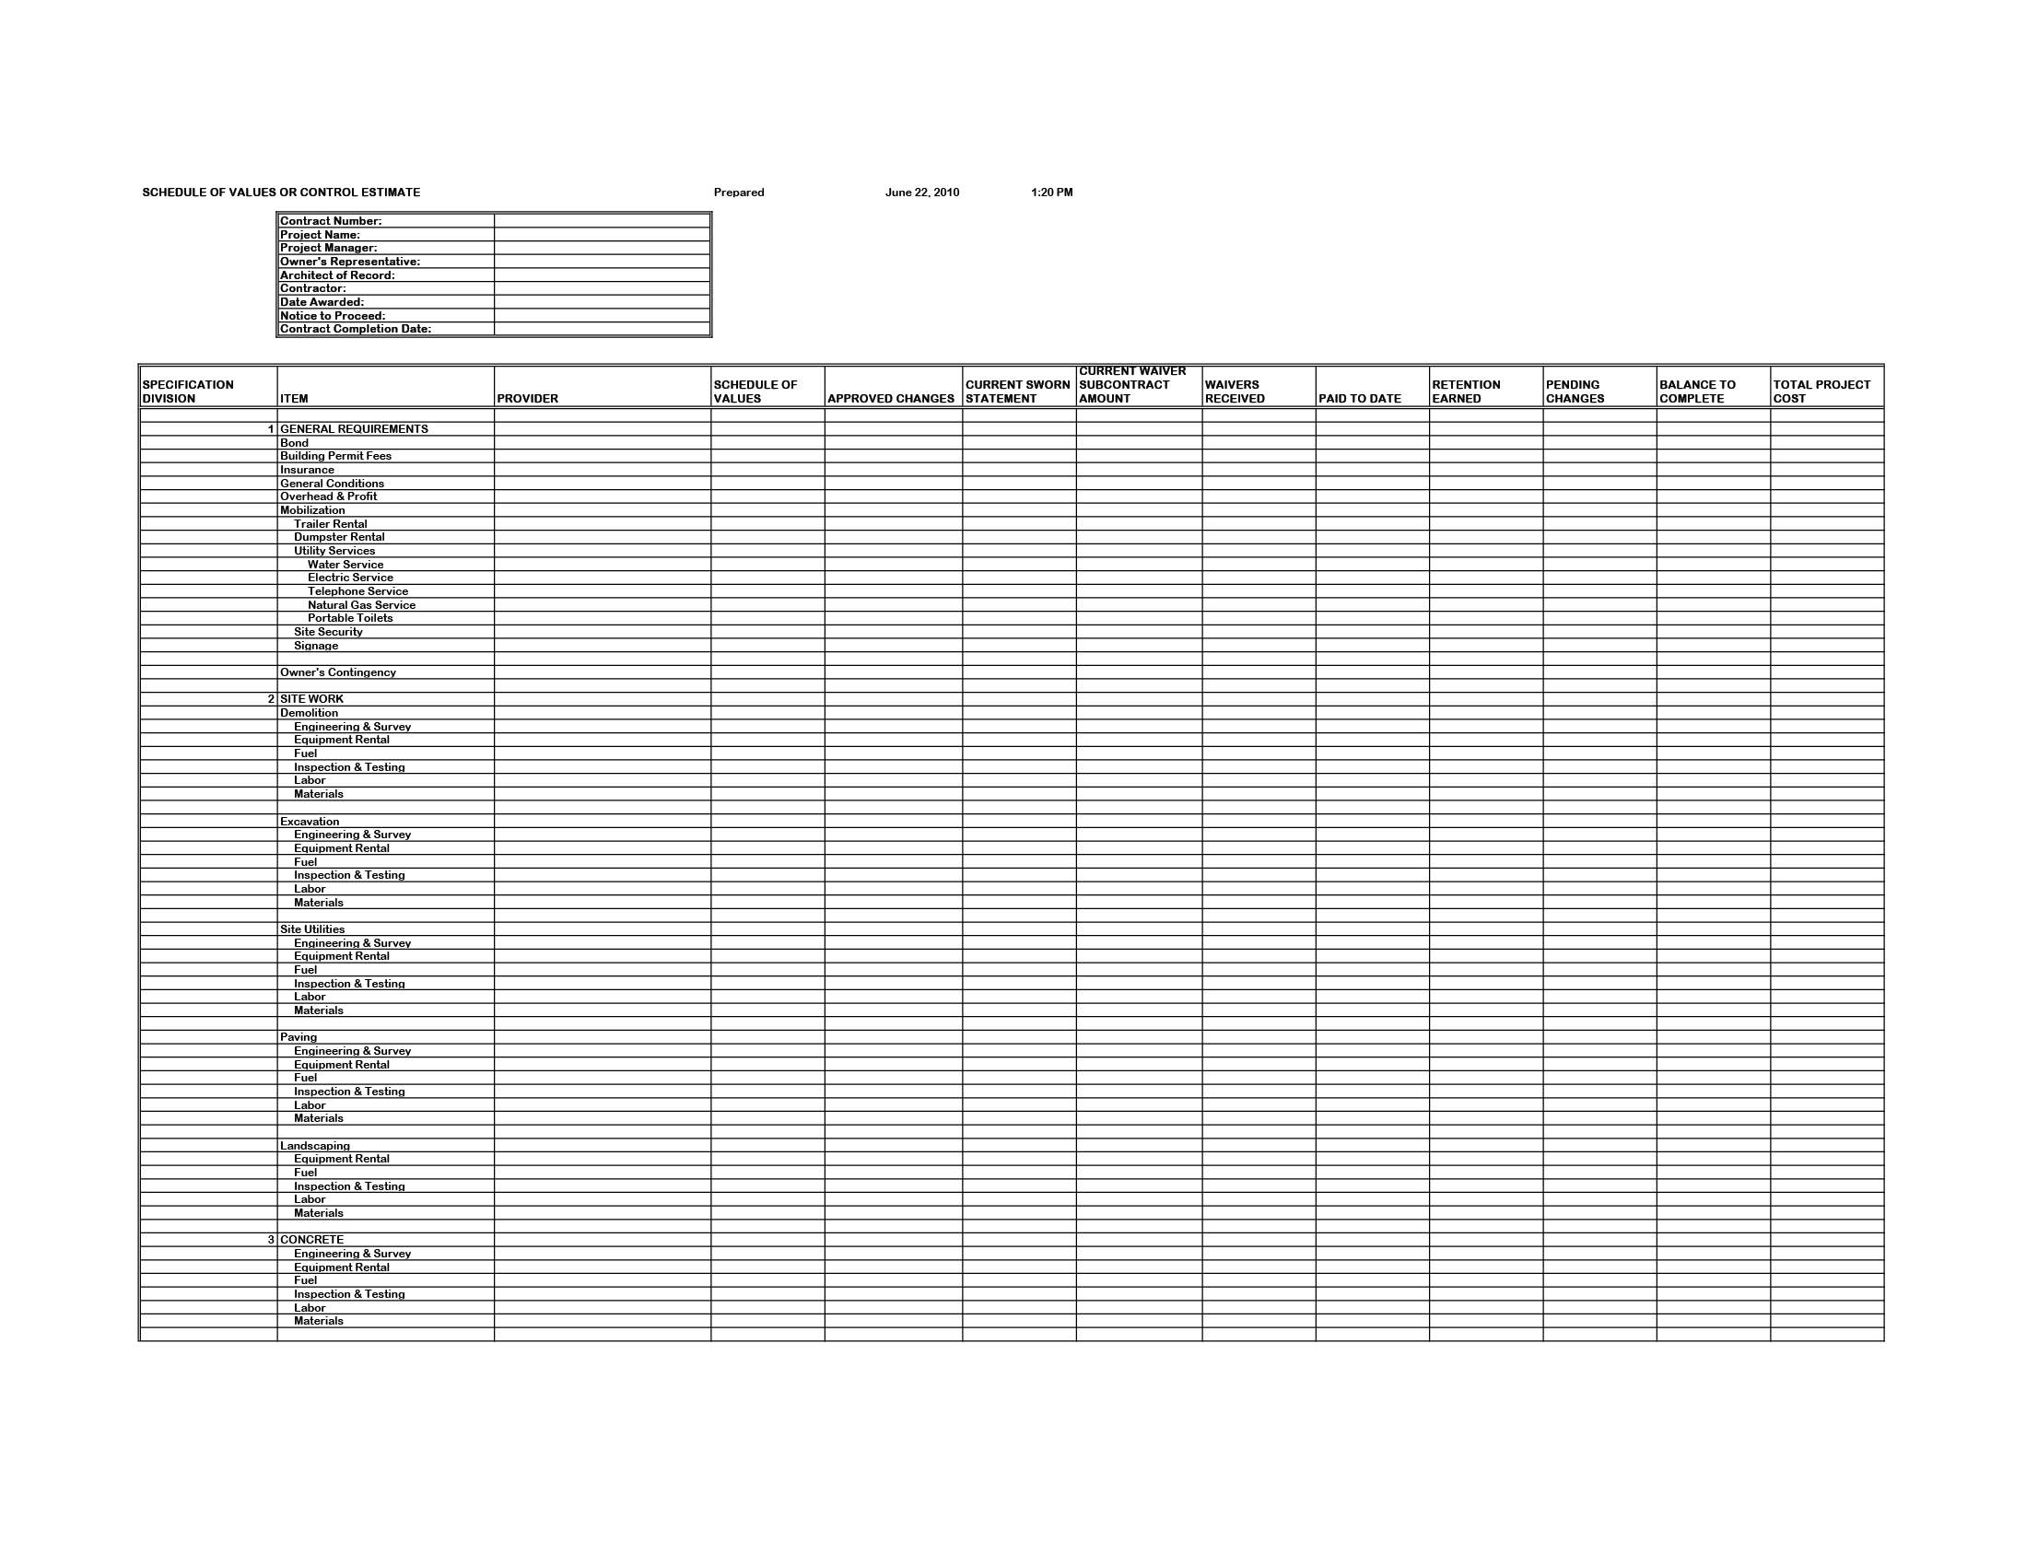
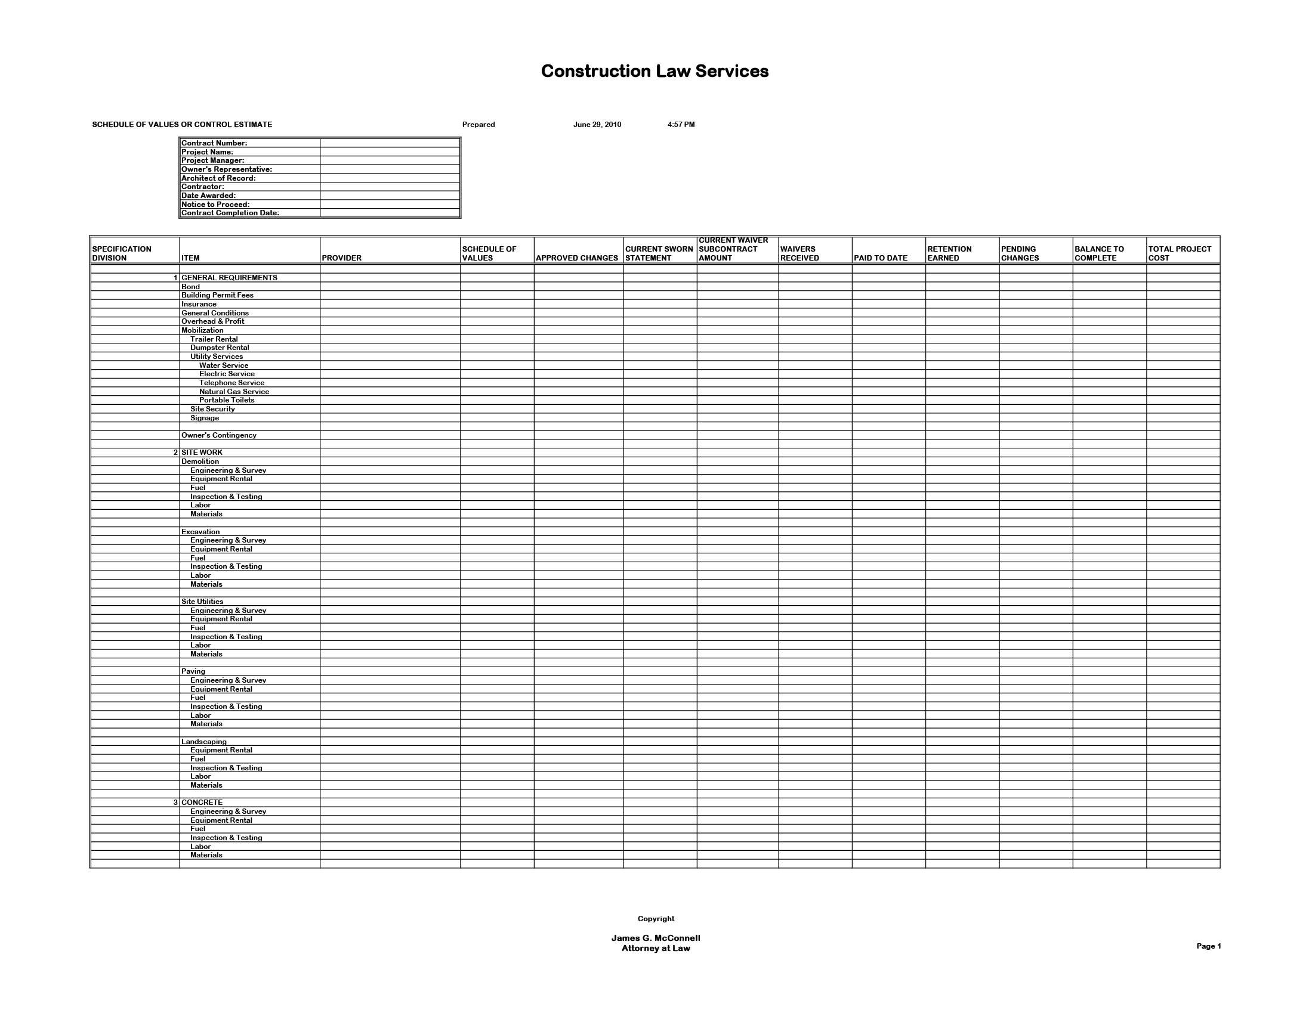
Notes:
These slides show the AIA division of construction scope into 16 divisions of work according to the trades involved in performing the work. Reference to this form can help identify labor or materials which may be missing from the contractor’s sworn statement.

Slide 12
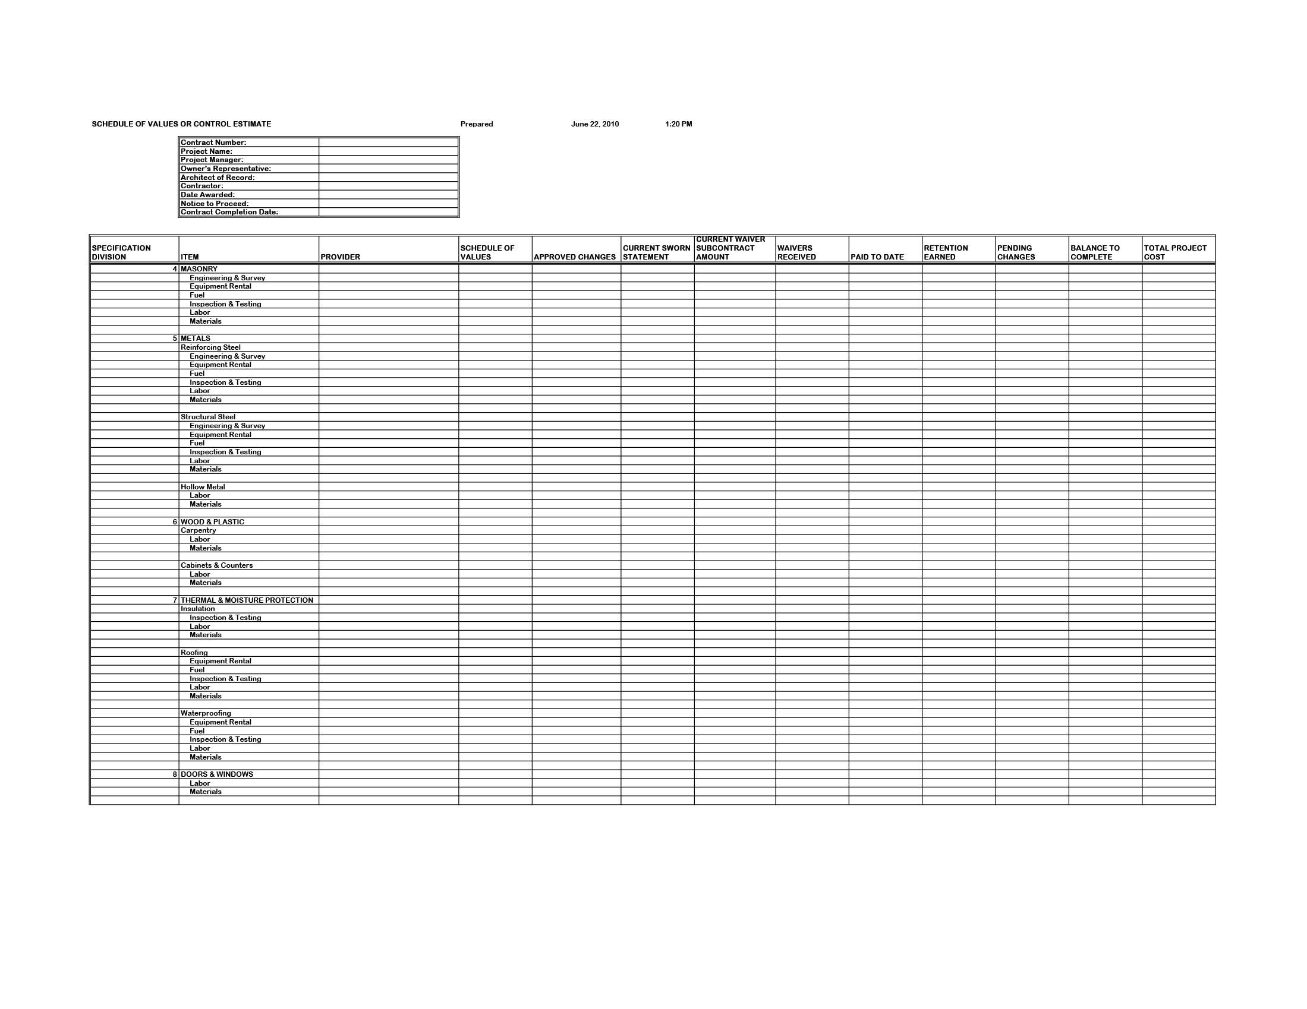
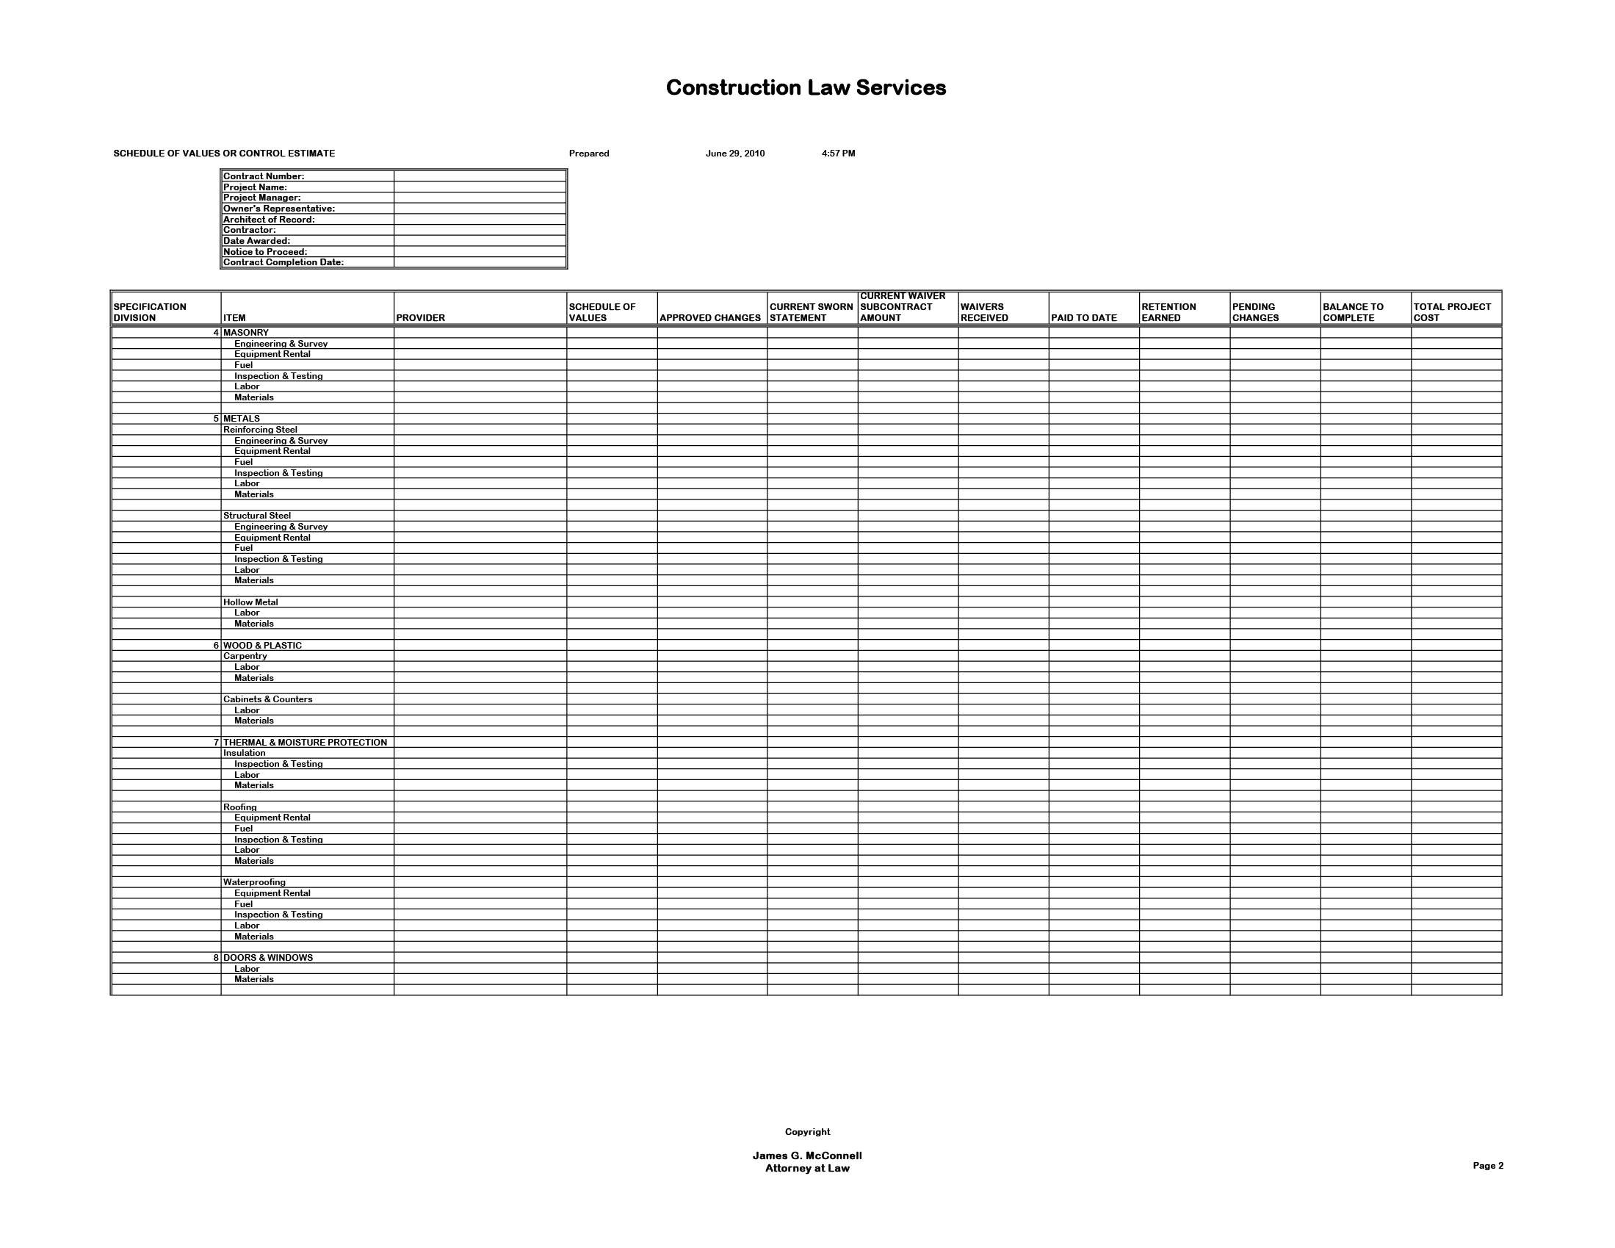

Slide 13
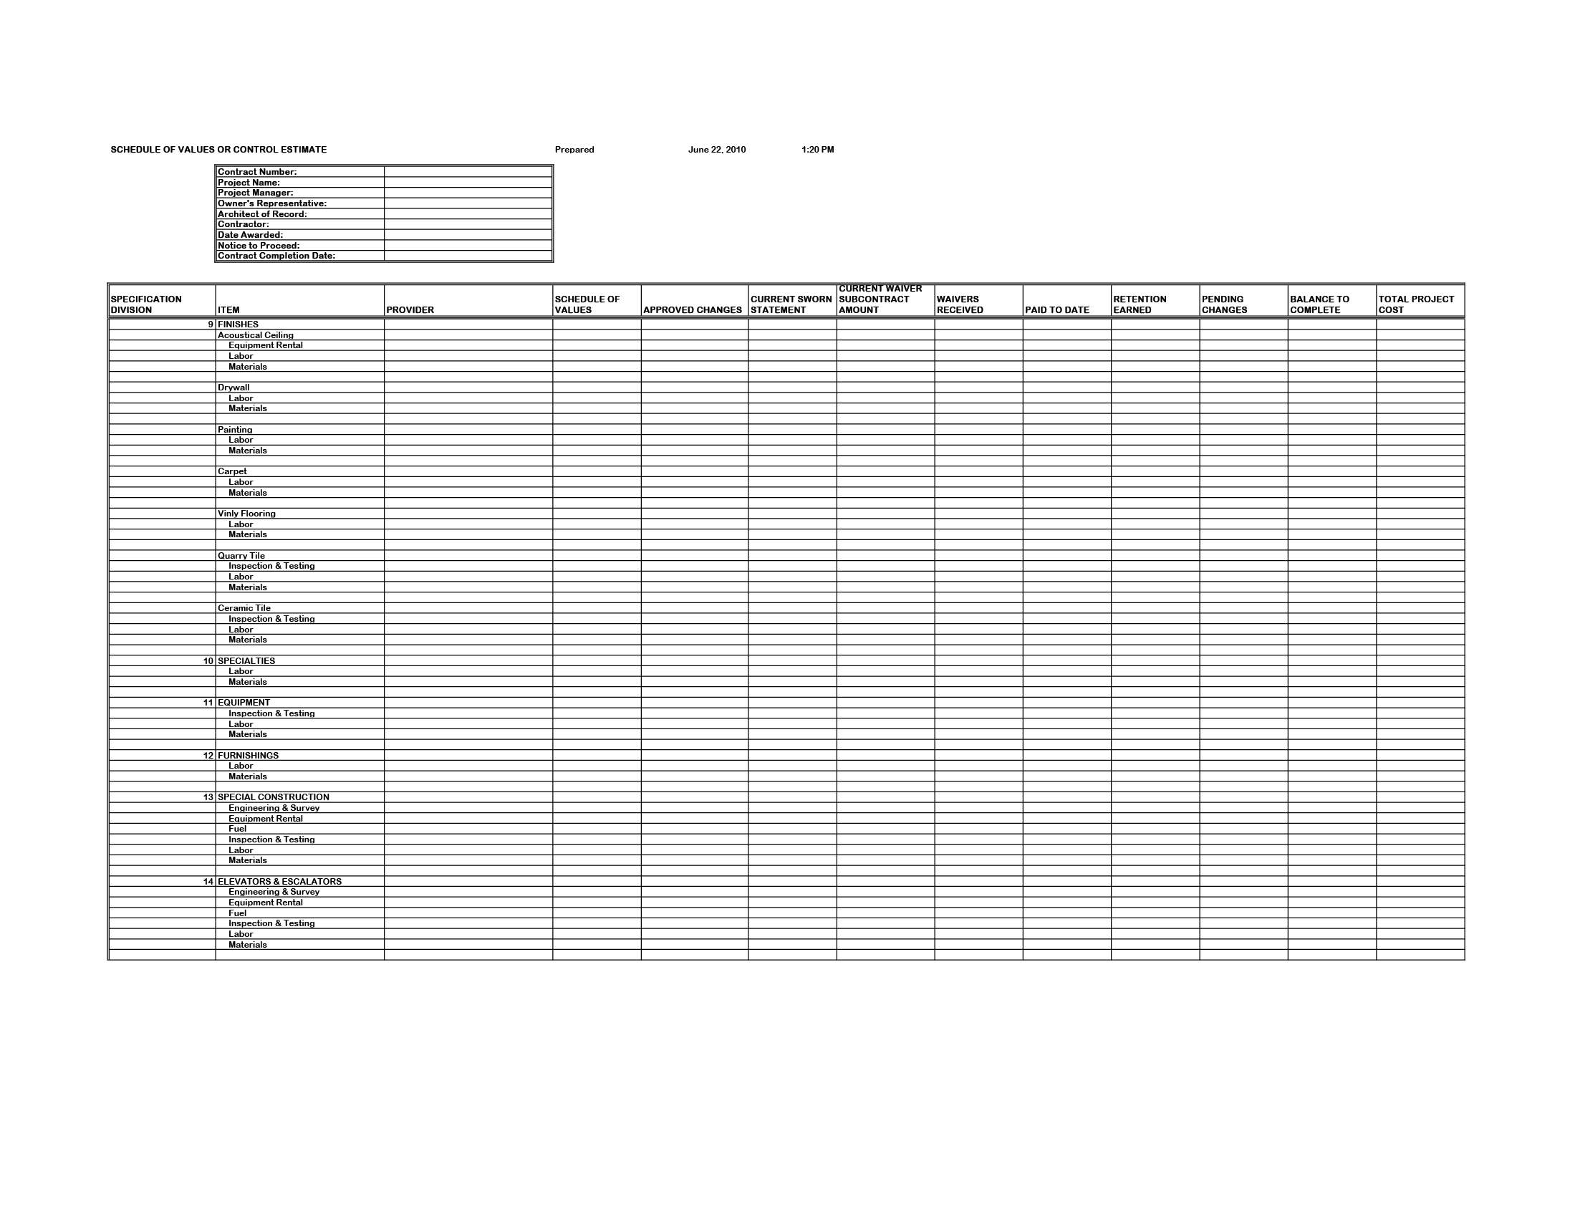
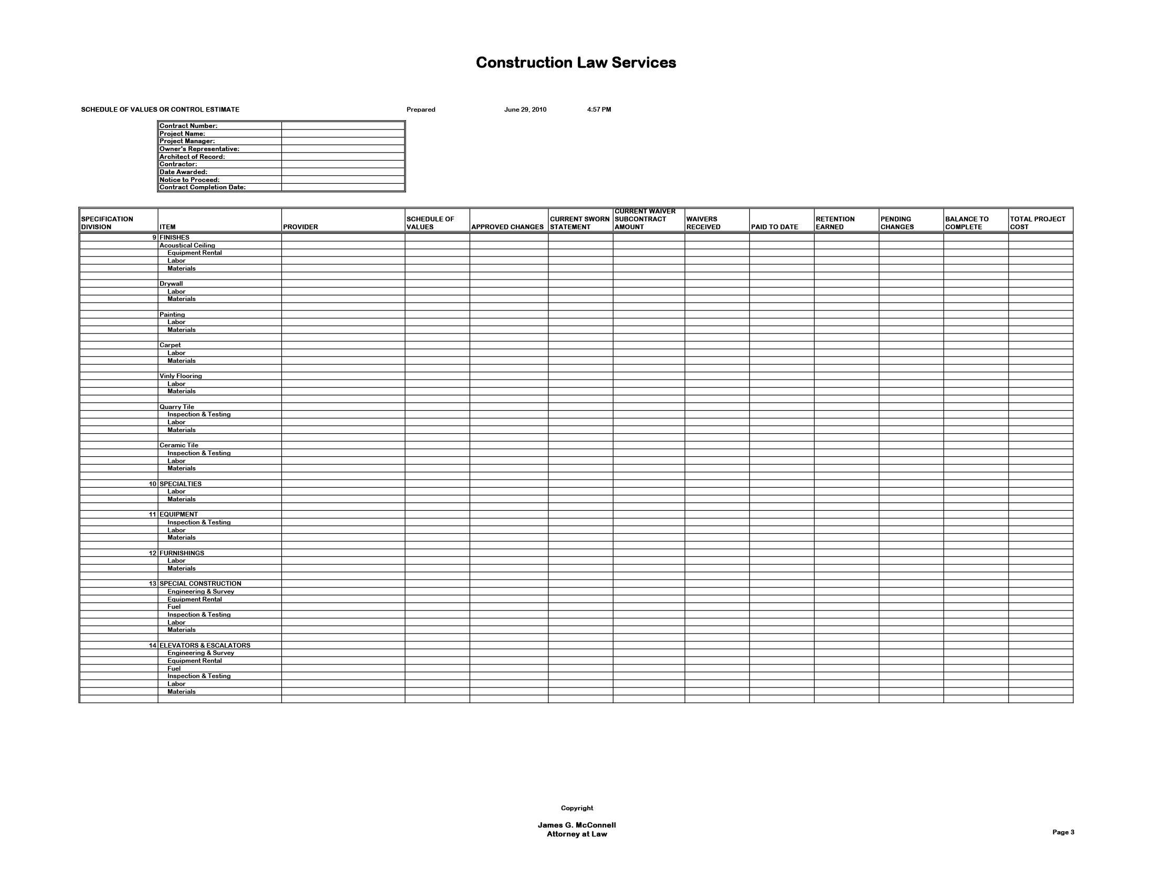
Notes:
Division 10 Specialties:
Toilet partitions
Washroom accessories
Cubicles
Built in audio visual equipment
Fire extinguishers
Lockers and shelving
Locker room benches
Moveable walls
Projection screens
Bulletin boards
Signage
Division 13 Special Construction:
Bank vaults
Greenhouses
Cold storage rooms
Soundproof rooms
Broadcast studios
Saunas
Clean rooms
Athletic courts

Slide 14
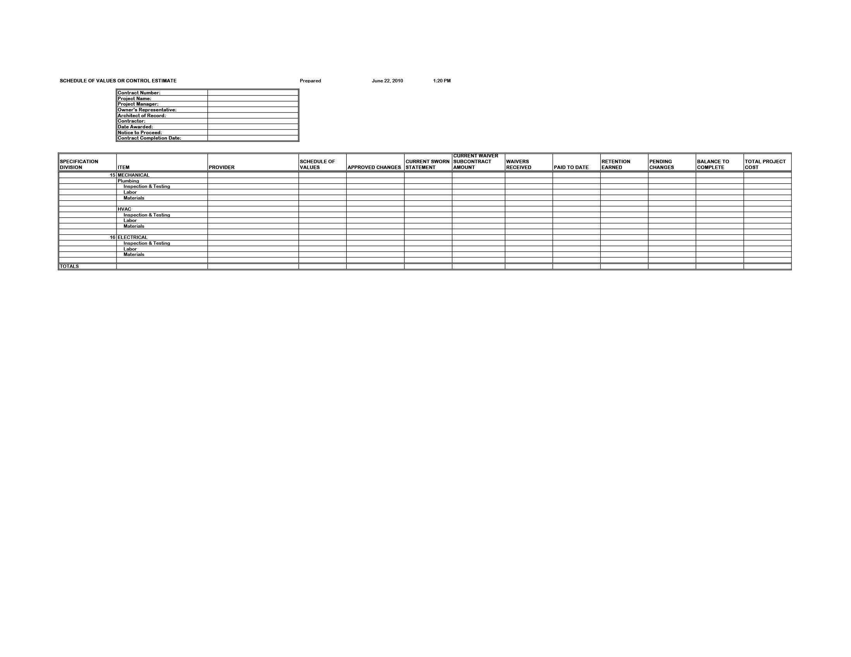
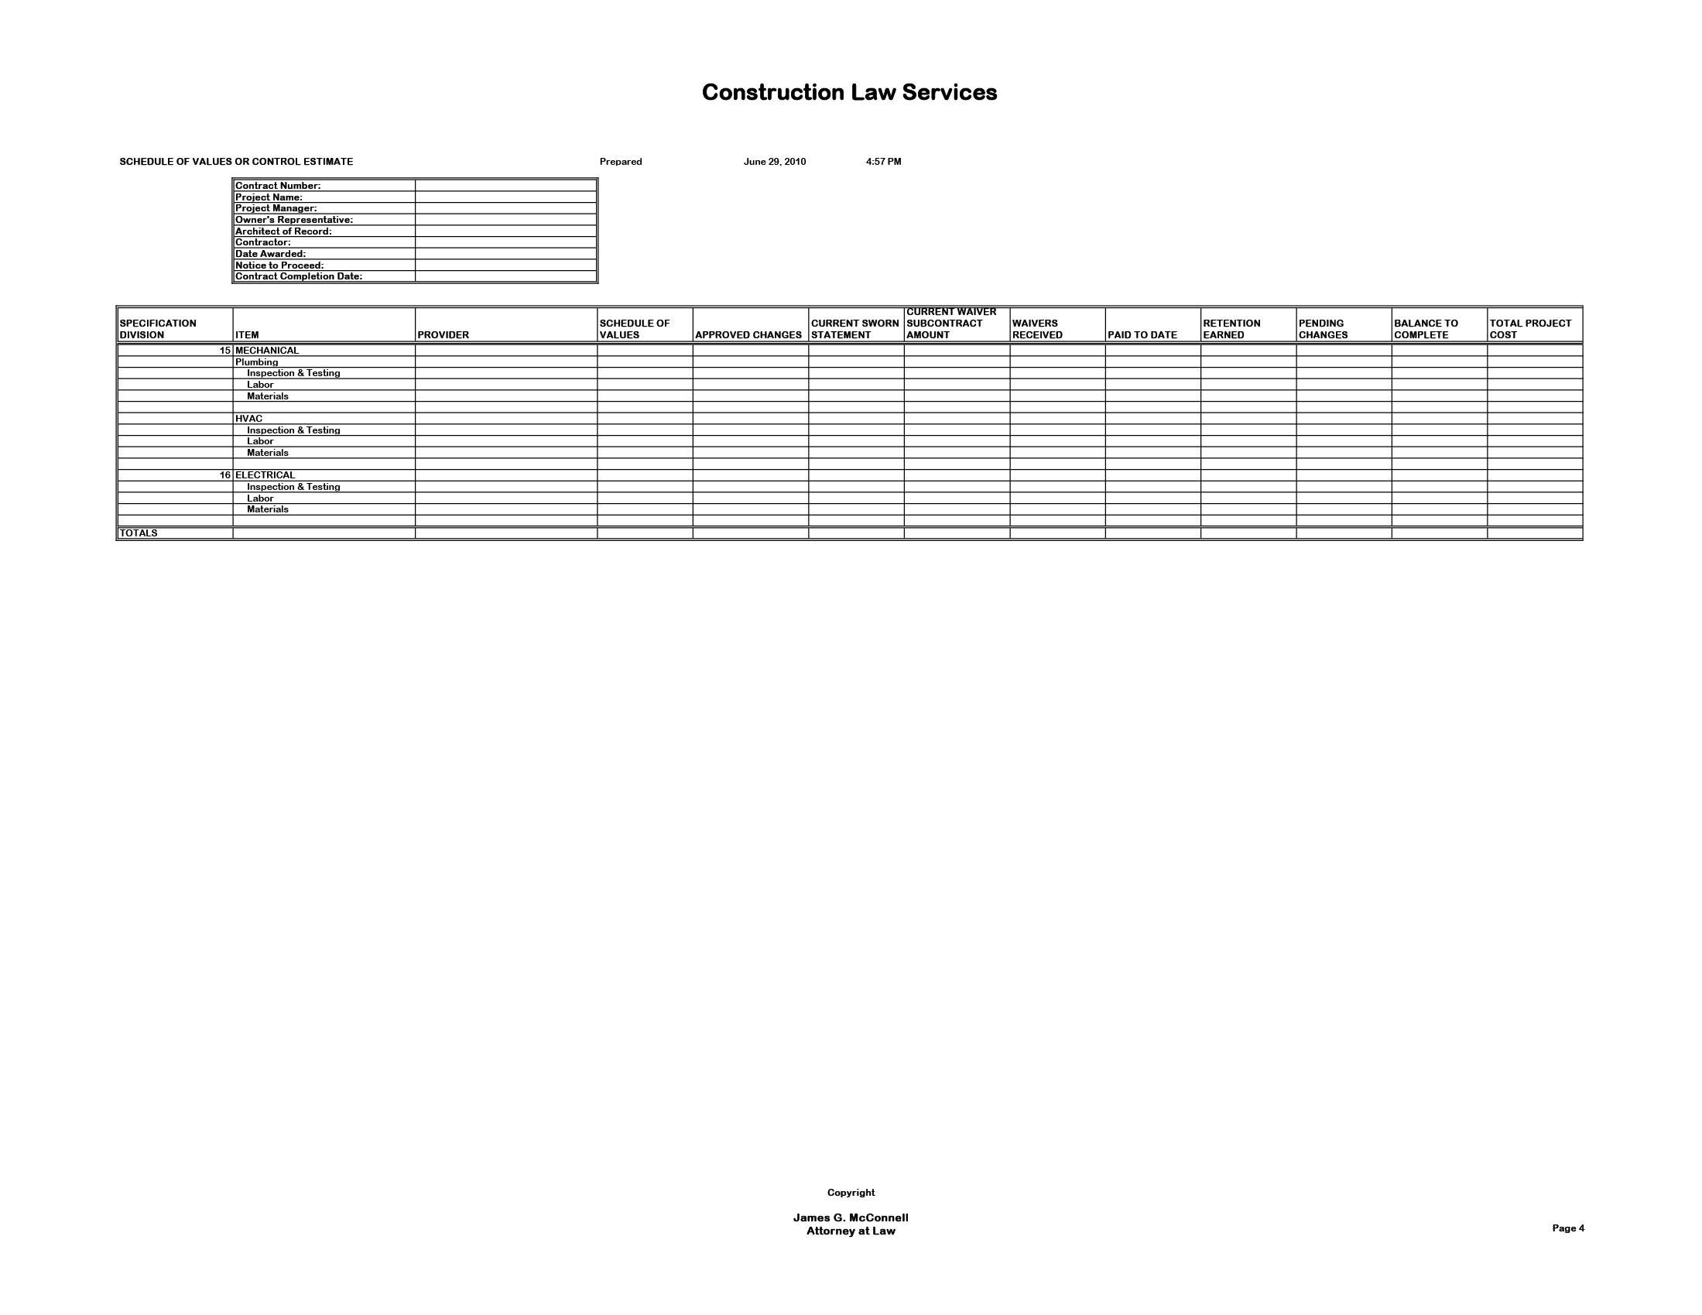

Slide 15
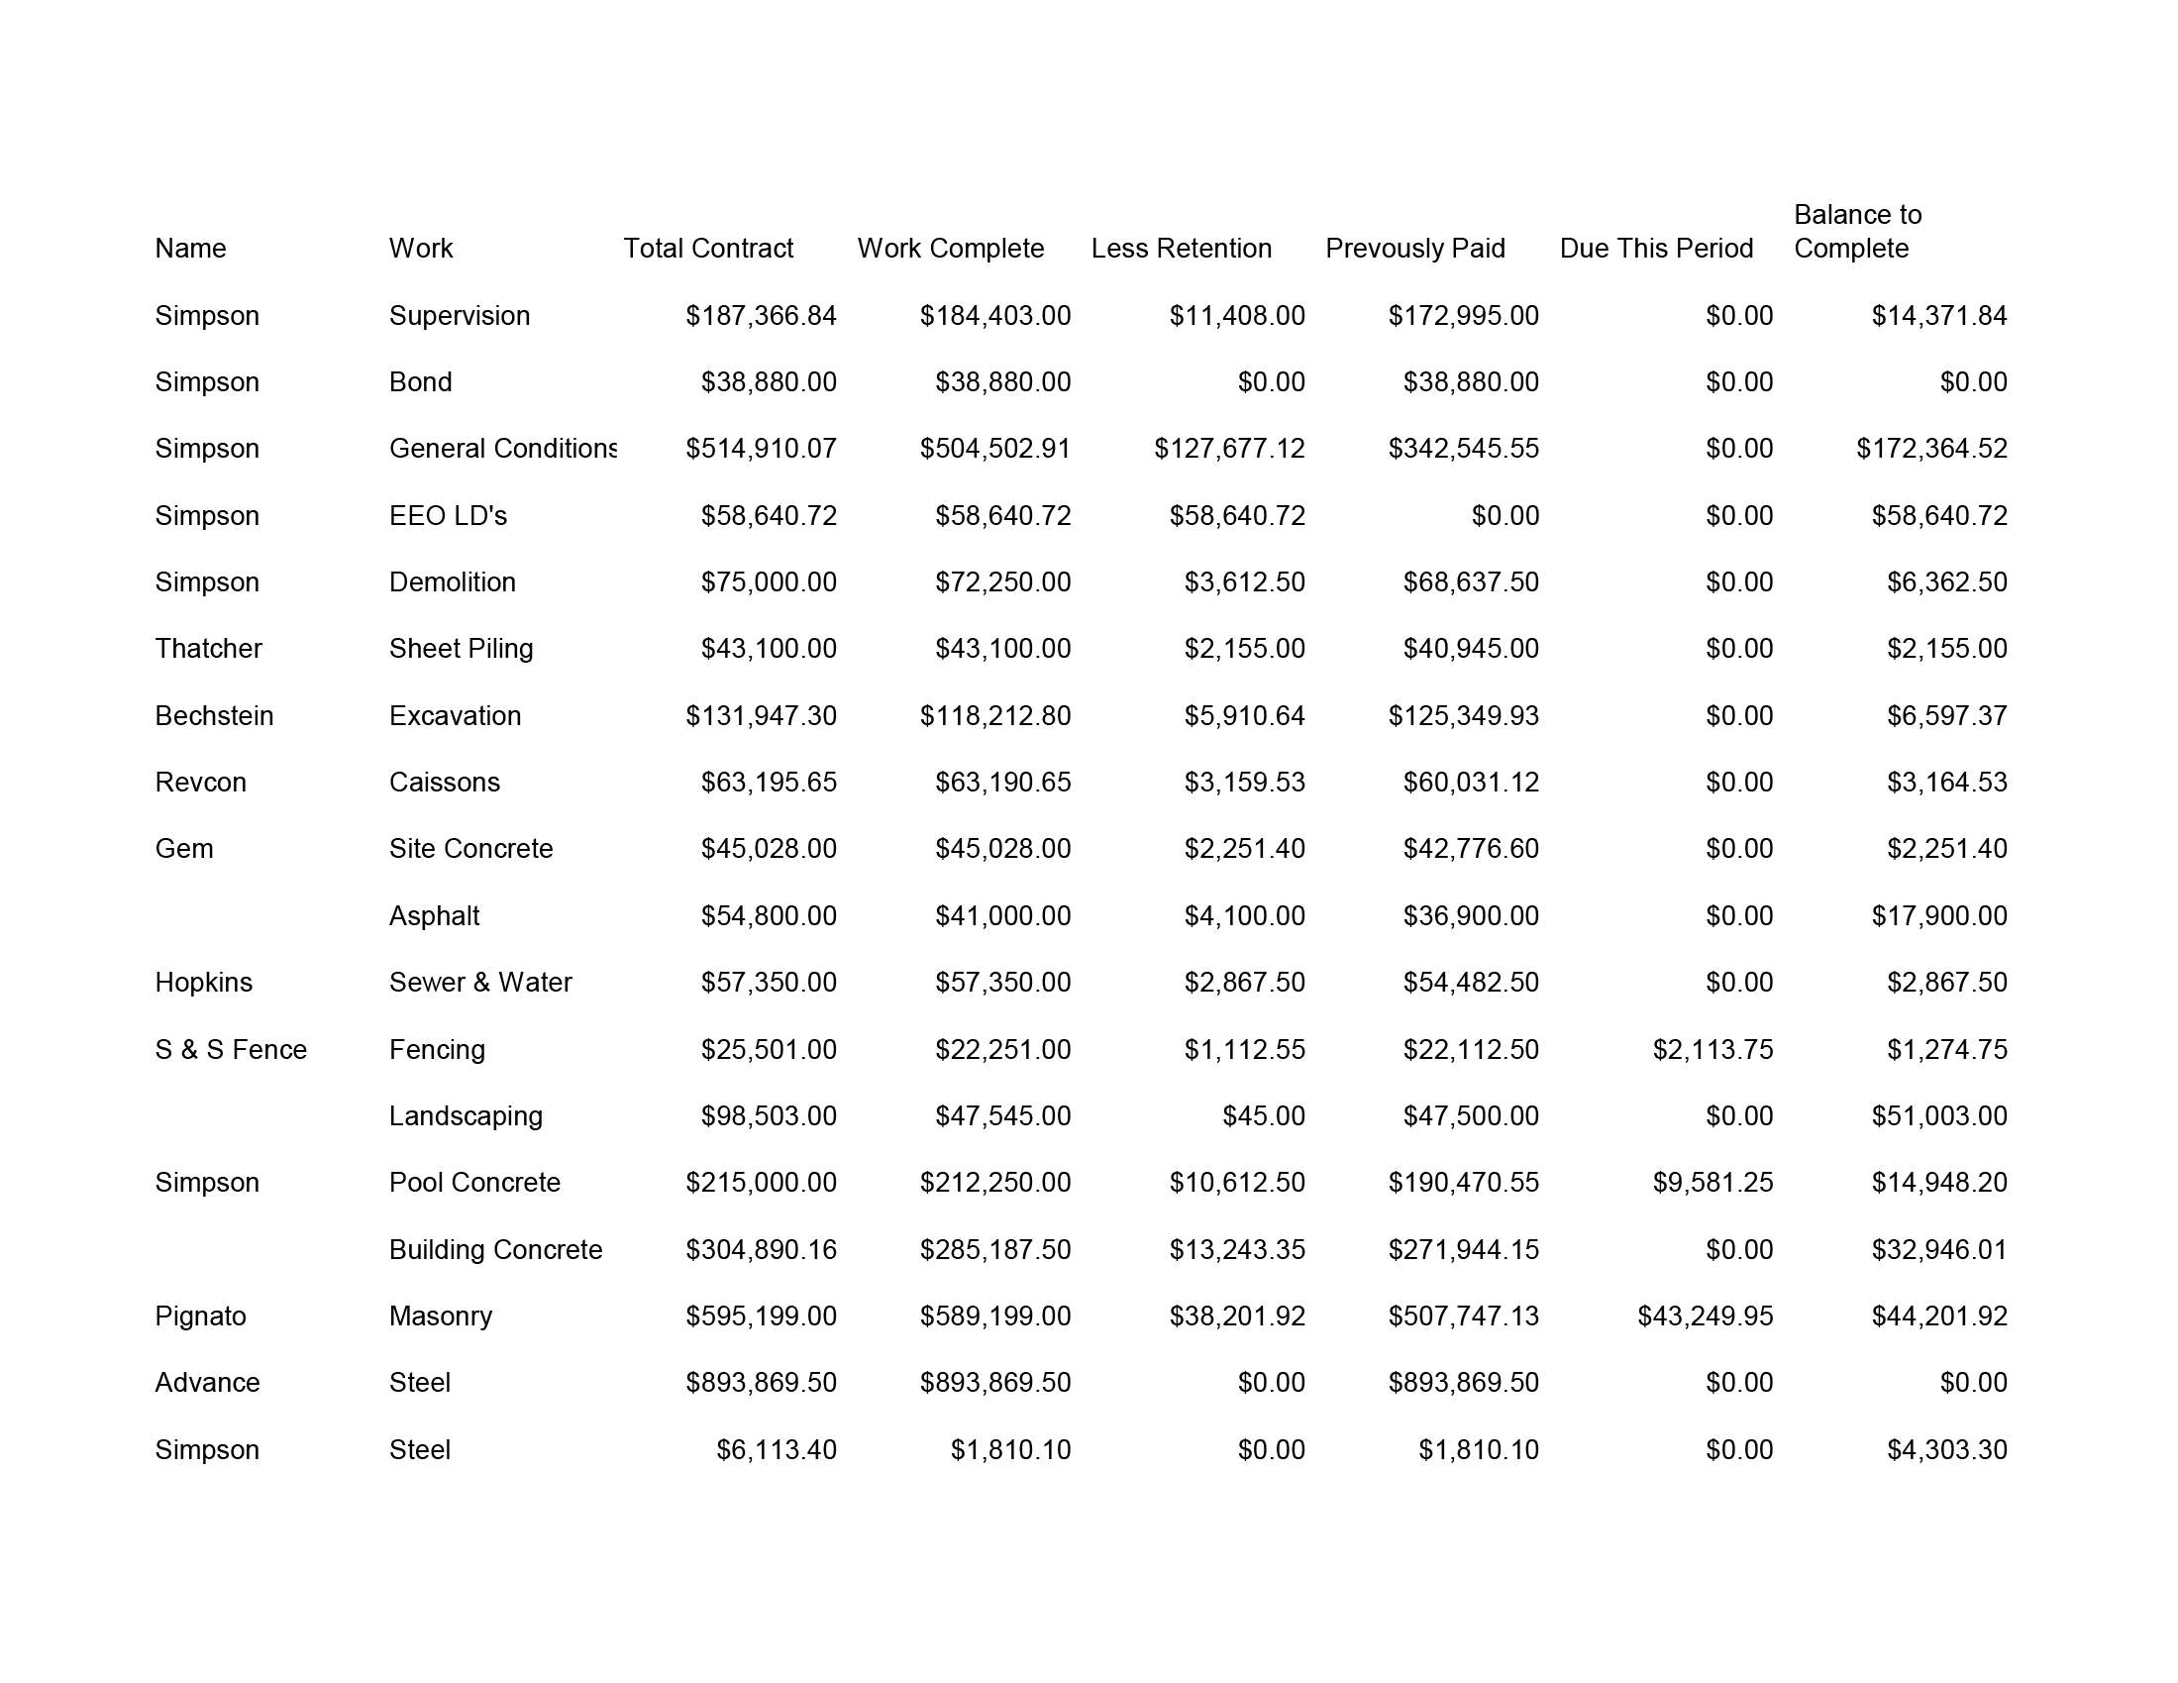
Notes:
This is a typical contractor’s sworn statement from a public project. Note that it is organized somewhat more closely according to the AIA 16 divisions, but still does not include work in all 16 divisions.

Slide 16
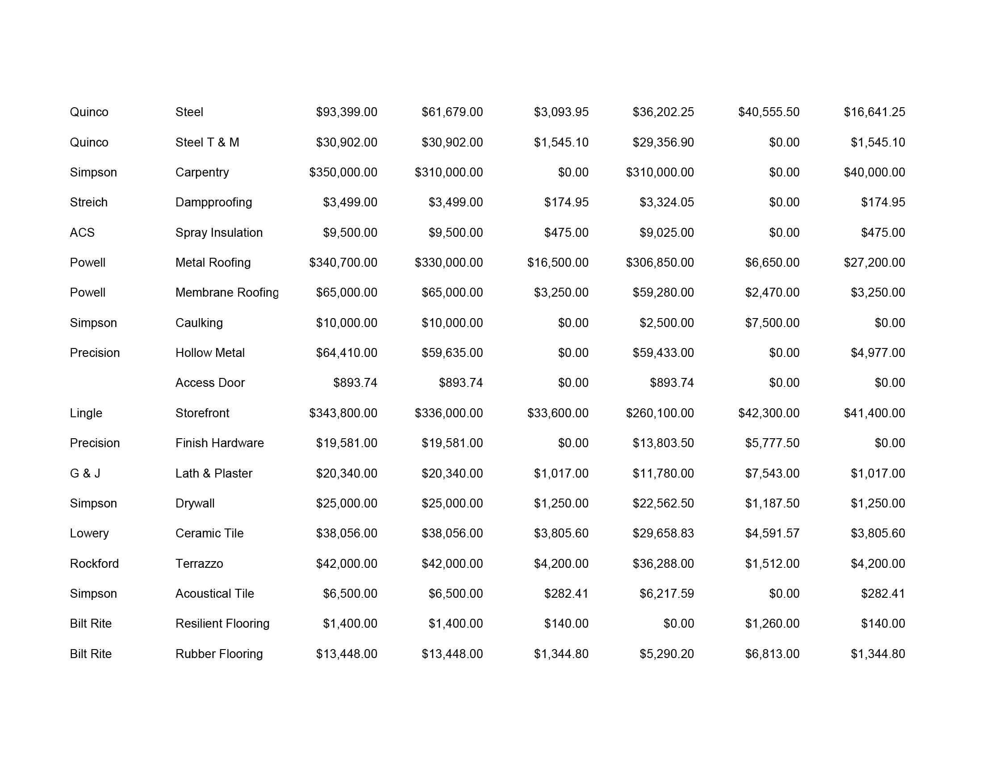

Slide 17
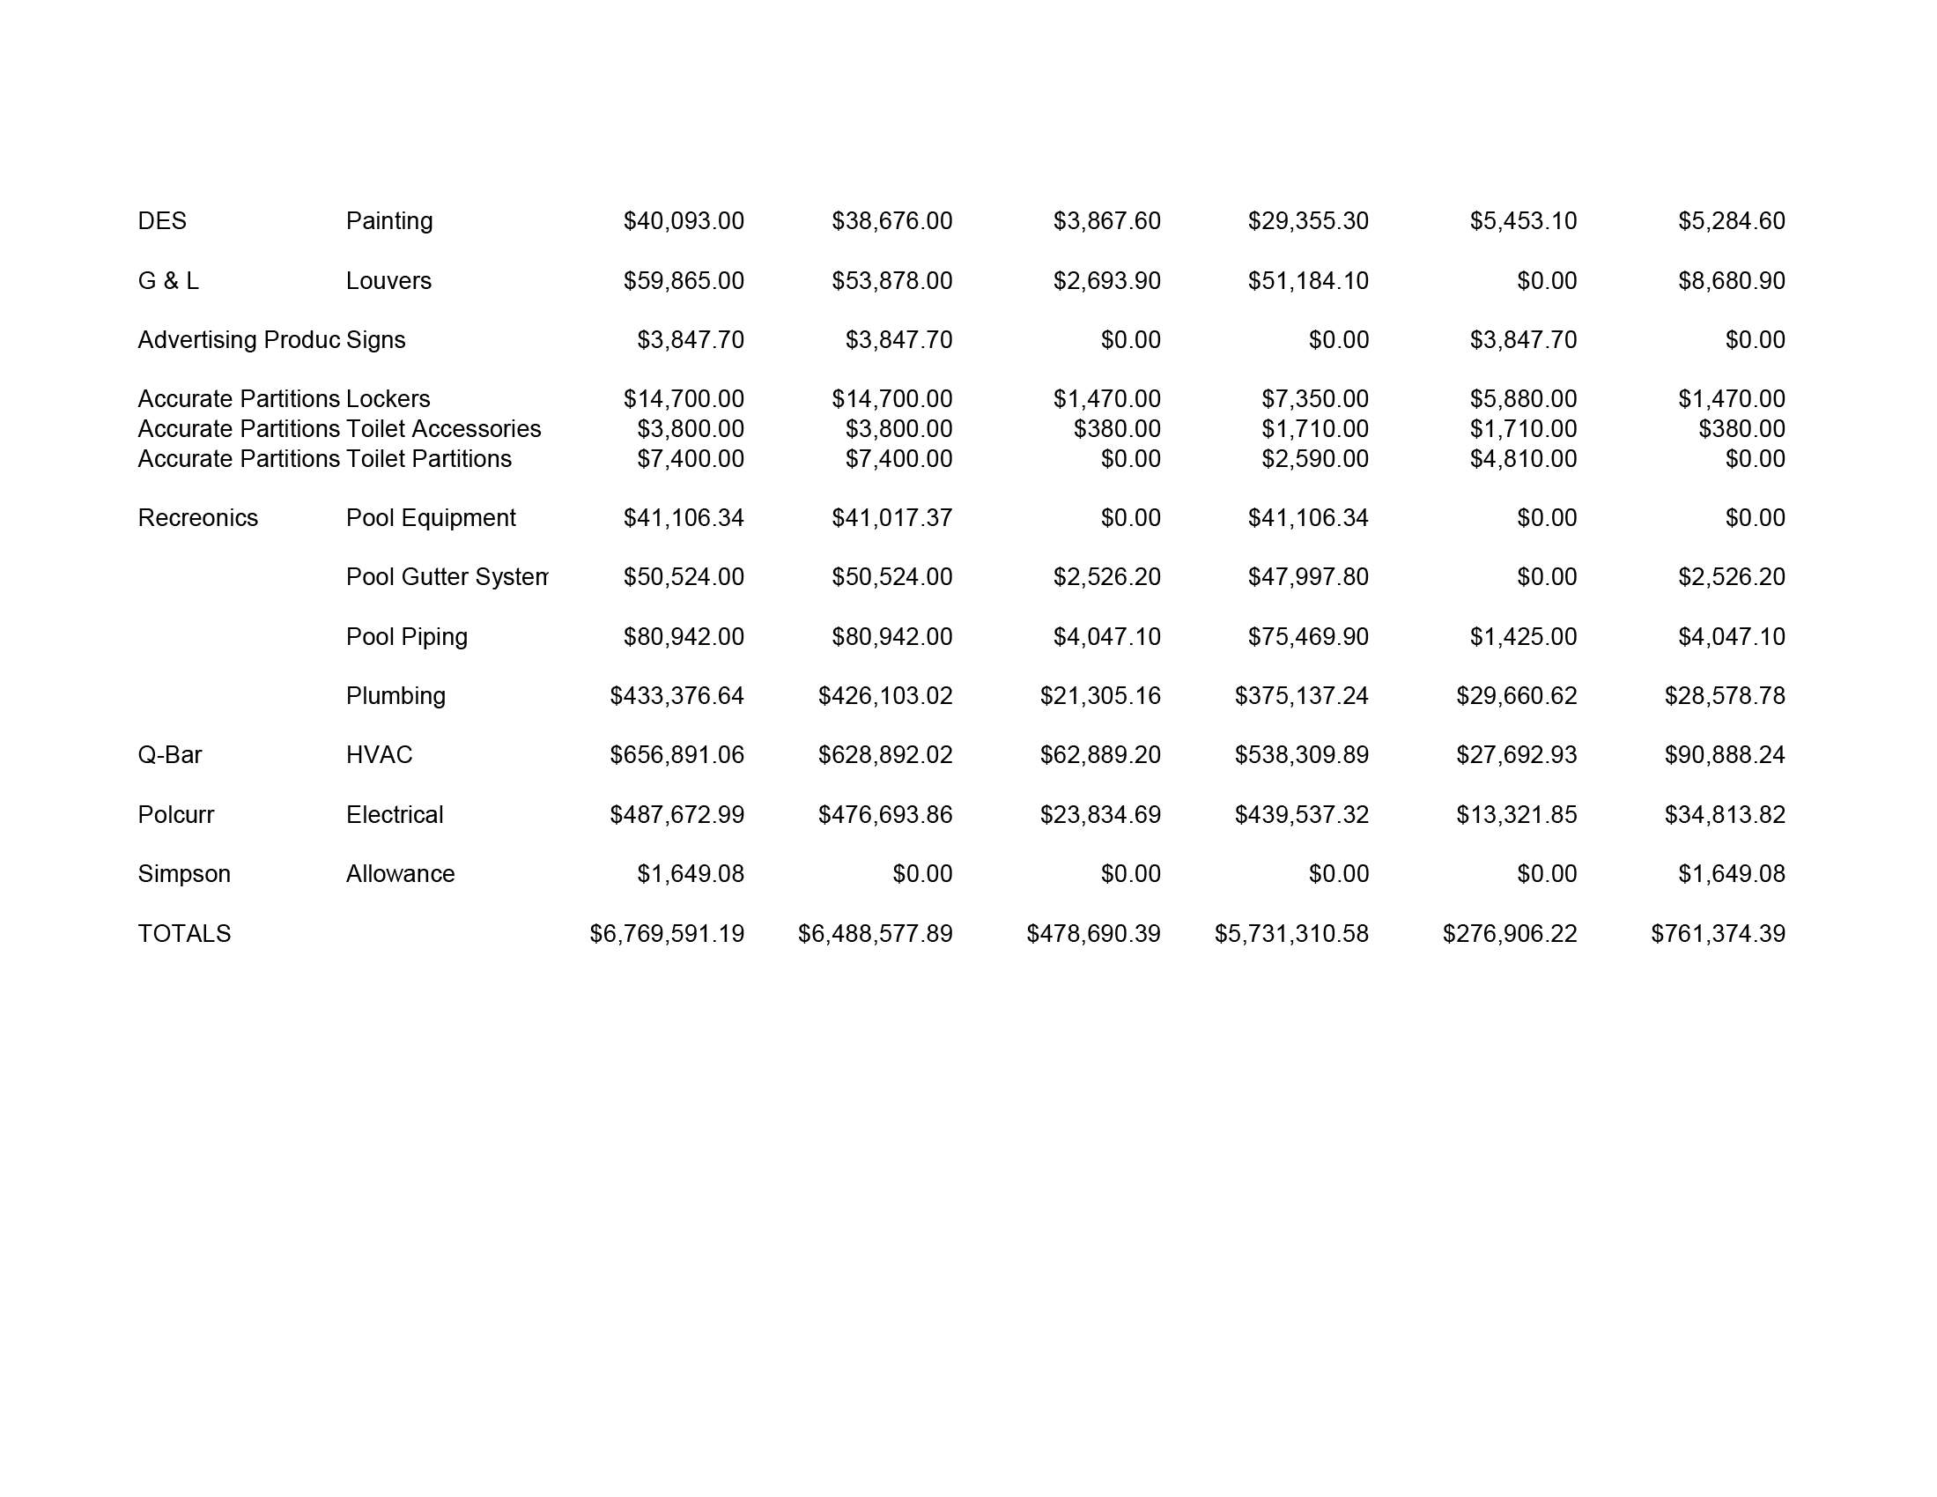

Slide 18
Lien Waivers With Payment
Trailing or current lien waivers
Trade contractor waivers identify and include material suppliers
Waivers must balance to sworn statement
Joint checks to protect owner interests

Slide 19
Perfecting And Prosecuting Lien Claims
Lien valid as long as appropriated funds remain unexpended
Lien perfected with service of notice on appropriate official
Service of notice freezes cash to the extent of claimed lien amount
Foreclosure action must be filed within 90 days after notice

Slide 20
Lien Notice Information
Proper public official
Correct identification of public contract
Date and scope of subcontract
Total value of work performed
Total payments received
Amount claimed as lien

Slide 21
Foreclosure Suit Information
Date lien notice served
Other notices on project
Appropriated funds remaining unspent
Balance to complete from sworn statement
“Funding strips” from all sources

Slide 22
Construction Law Services LLC
James G. McConnell
Attorney at Law
Suite 208
11966 H Oak Creek Parkway
Huntley, Illinois 60142
Phone (630) 748-8036
Fax (630) 243-5682
Worldwide Cellular (312) 287-1343
E-mail
james.mcconnell@james-g-mcconnell.com

